Slide 1

Processing Airline Data
Github.com/deonlove916/Airline-Data

Slide 2


Technologies Used:
OpenFlights: Airport and airline data

Slide 3
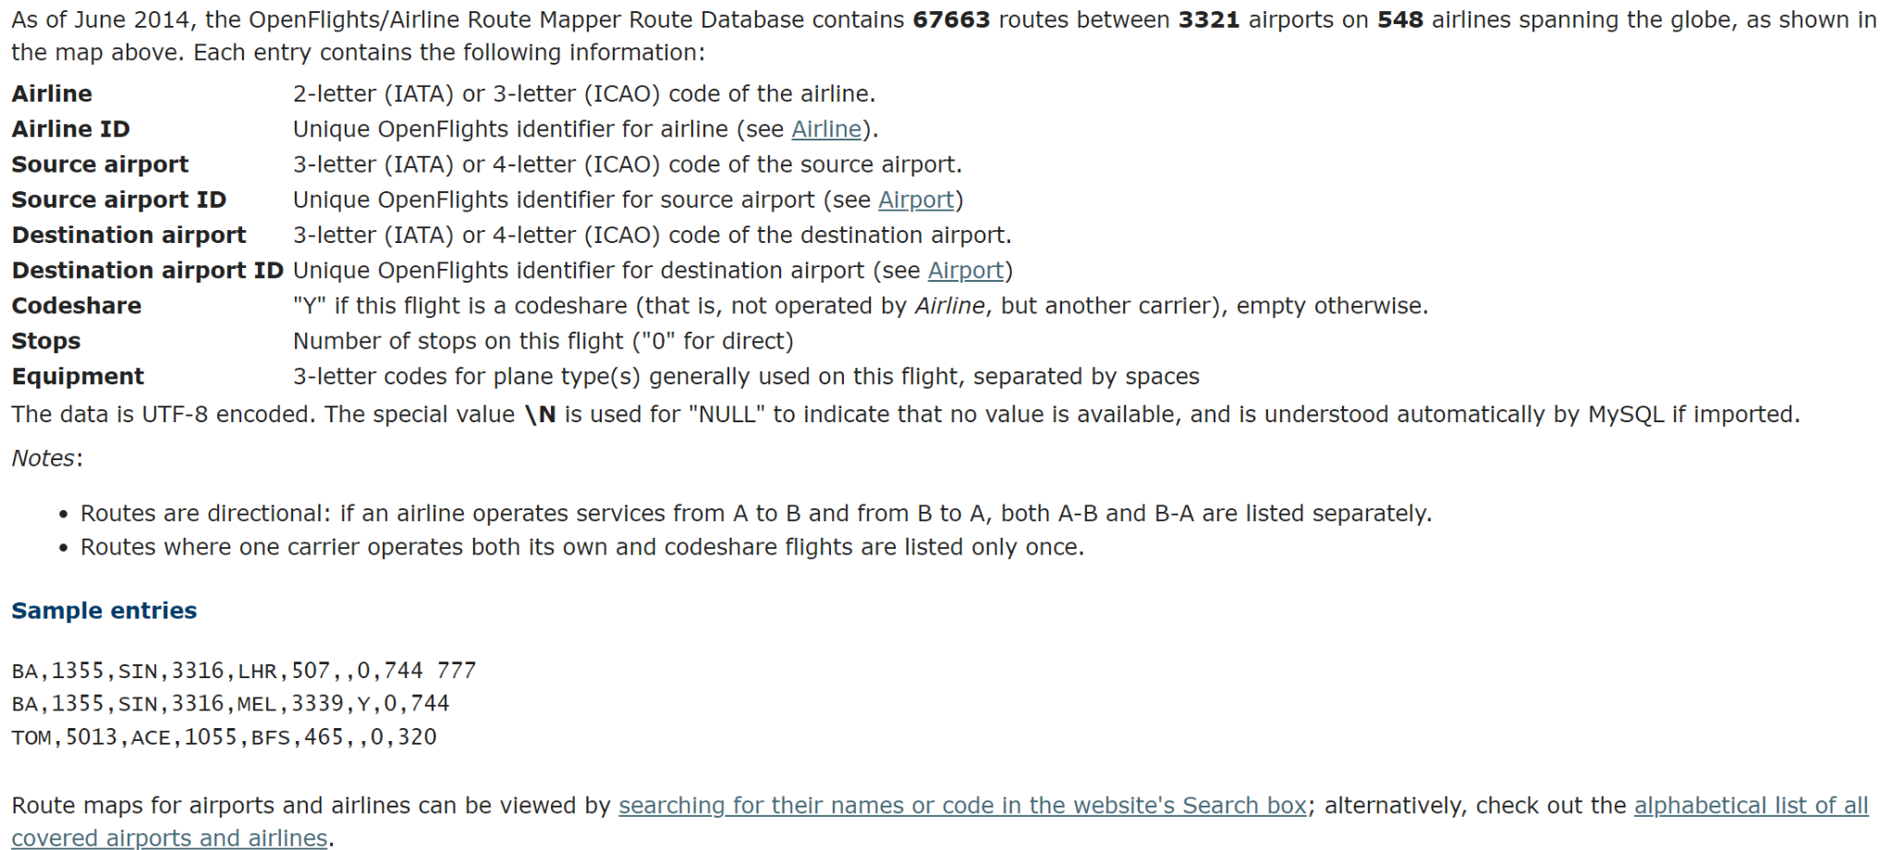
Data Provided by OpenFlights.org

Slide 4

Data Cleaning
The data file didn’t have column names, I added the names as listed on website.
I cast the data type int to columns that were imported to data frame as strings.
I removed Null values from columns used for processing.

Slide 5
Functionality
Airports that are least traveled as starting point of a route.
Airports that are most traveled as starting point of a route.
Airports that are most traveled as ending point of a route.
Airports that are the least traveled as ending point of a route.
Manual selection of the number of returned items. (Top 10, Top 5, etc.)

Slide 6

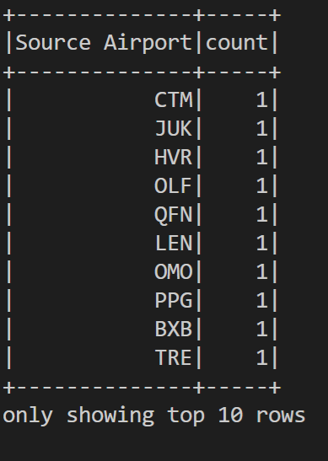
Examples

Slide 7
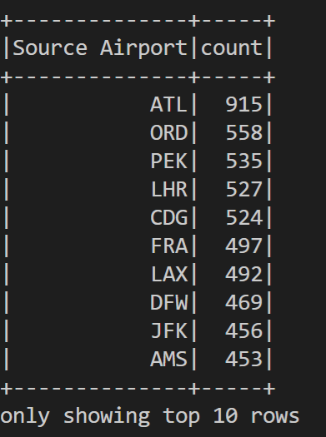
Examples

Slide 8
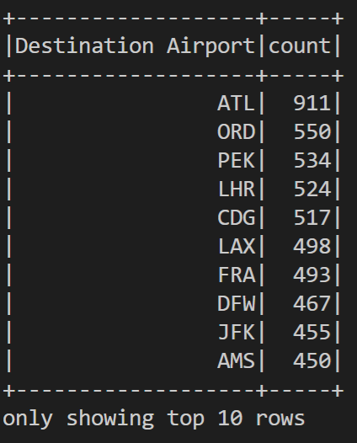
Examples

Slide 9

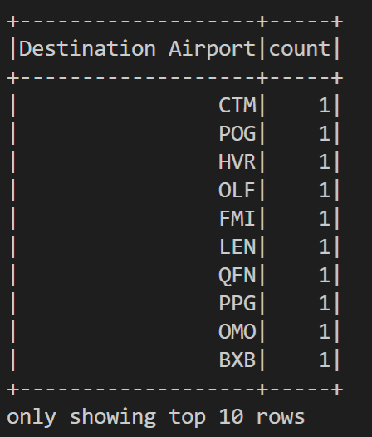
Examples

